Slide 1
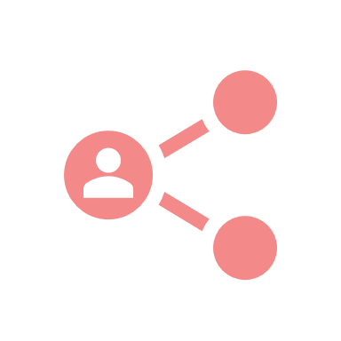




*user- the customer who the gets the food through the app.
Juncture 1
Juncture 3
Juncture 5
Login/Signup
User receives notifications
Supplier is notified on booked food
Supplier post excess food details
User books required food
The Food is snapped up
Juncture 2
Juncture 4
Juncture 6
ROADMAP
*supplier- who post the food through app.

